Slide 1
Web Application Architecture
Lecturer: Ngo Huy Bien
Software Engineering Department
Faculty of Information Technology
University of Science
Ho Chi Minh City, Vietnam
nhbien@fit.hcmus.edu.vn

Slide 2

Objectives
To present general multiple page web application architecture.

Slide 3

Contents
Web Application

Slide 4

References
Jim Conallen (1999). Modeling Web Application Architectures with UML.
Daniel Schwabe and Luiselena Esmeraldo (2001). Engineering Web Applications for Reuse.
Deepak Alur et al. (2003). Core J2EE Patterns Best Practices And Design Strategies.

Slide 5
What is a Web Application? [1]
We’ll loosely define a web application to be a web system (web server, network, HTTP, browser) where user input (navigation and data input) affects the state of the business.
This definition attempts to establish that a web application is a software system with business state, and that its "front end" is in large part delivered via a web system.
A web application’s principal communication protocol is HTTP, which is a connectionless protocol that was designed for robustness and fault tolerance instead of maximum communication throughput.

Slide 6
Why Web Application?
One of the most significant advantages of a web application is its deployment.

Slide 7
How Does a Web Application Work?
Browsers request “web pages” from the server.
Each page is a mix of content and formatting instructions, expressed with HTML. Some pages include client side scripts that are interpreted by the browser.
The user views and interacts with the content in the page. Sometimes the user enters in information in field elements in the page and submits them to the server for processing.
The user can also interact with system by navigating to different pages in the system via hyperlinks.
In either case, the user is supplying input to the system that may alter the “business state” of the system.

Slide 8
Web Application vs. Web Site
The differences between a web application and a web site, even from a dynamic one, involve its usage.
Web applications implement business logic, and its use changes the state of the business (as captured by system).

Slide 9
Web Page
From the client’s perspective, the web page is always an HTML formatted document.
On the server, however, a “web page” may manifest itself in a number of different ways.
CGI scripts
Management of client state on the server
Transaction processing integration
Remote administration
Resource pooling

Slide 10
CGI scripts
Scripted pages. Each web page that a client browser can request is represented on the web server’s file system as a scripted file. This file is typically a mix of HTML and some other scripting language. When the page is requested, the web server delegates the processing of this page to an engine that recognizes it, with the ultimate result that an HTML formatted stream is sent back to the requesting client.
Compiled pages. The web server loads and executes a binary component. This component, like with scripted pages, has access to all the information that came along with the page request (values of form fields and parameters). The compiled code uses the request details, and typically accesses server side resources to produce the HTML stream returned to the client.
A hybrid represents scripted pages that, once requested, are compiled and this compiled version is then used thereafter by all subsequent requests. Only when the original page’s contents change, while the page undergoes another compile.

Slide 11
Request Routing
File mapping
Method mapping

Slide 12
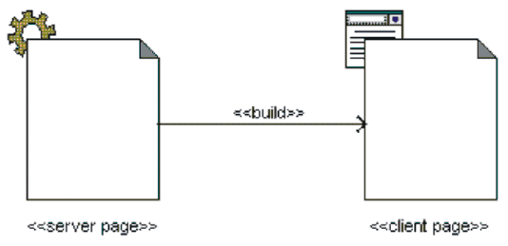
Server Page vs. Client Page
Every dynamic web page (that is, pages whose content is determined at runtime) is constructed with a server page.
Every client page is built by, at most, a single server page; however, it’s possible for a server page to build multiple client pages.

Slide 13
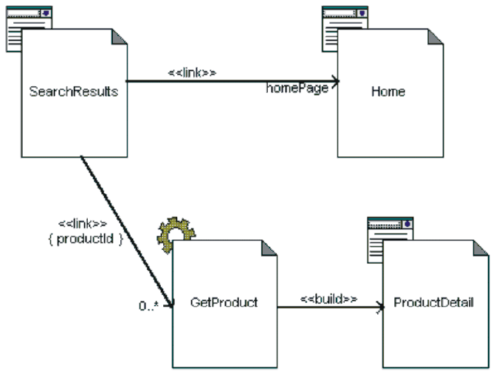
Hyperlinks

Slide 14
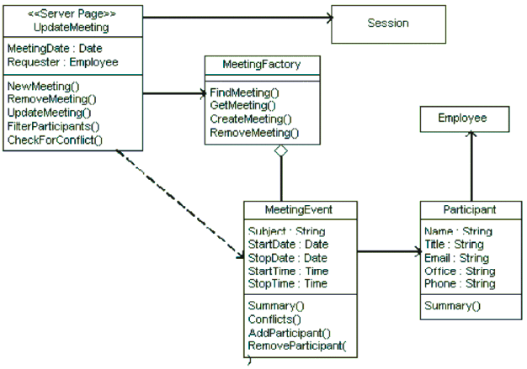
<<Server Page>>
The «server page» is simply another class that participates in the business logic of the system.
At a more conceptual level, server pages typically take on the role of controllers, orchestrating the necessary business object activity to accomplish the business goals initiated by the browser’s page request.

Slide 15
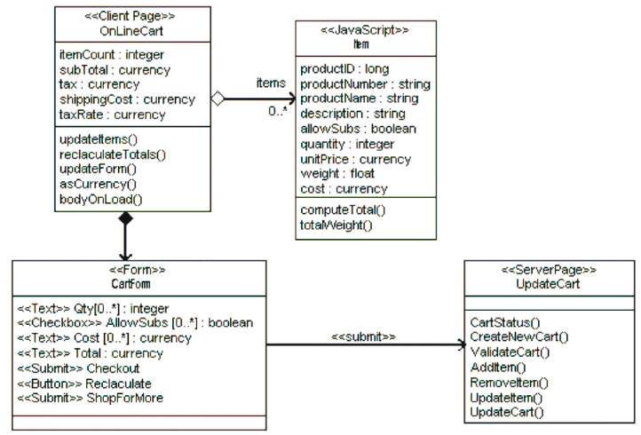
<<Client Page>>

Slide 16


Slide 17
Web Application Design Concerns [2]
Application domains grow ever more sophisticated, users need easier browsing to access more multimedia data, and new appliances require easy-to-use Web interfaces.
To help designers manage the problem of the Web’s complexity, we can separate three essential modeling concerns:
application behavior,
navigational modeling, and
interface design.
Separation of concerns provides not only a solid ground for Web software evolution but also a basis for maximizing design and implementation reuse.

Slide 18
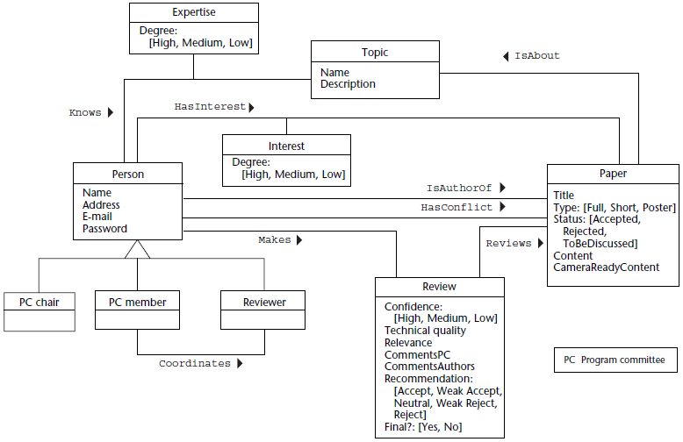
Application Behavior

Slide 19
Navigational Modeling
Each node class consists of attributes combined from different conceptual classes.
Links indicate navigation paths and reflect conceptual relationships.
The navigational schema contains node classes and link relationships that indicate the basic navigation architecture.

Slide 20
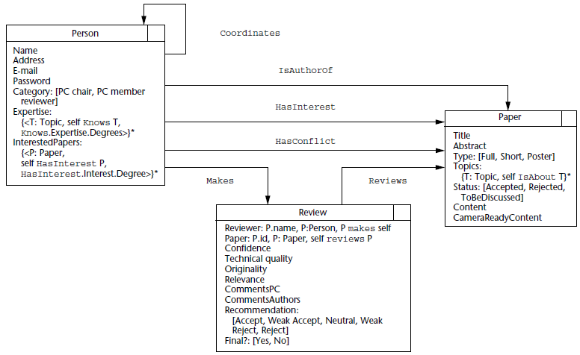
Navigation Model Example

Slide 21
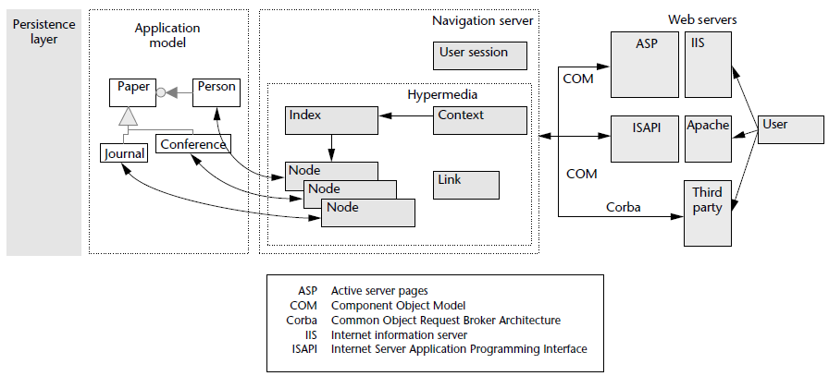
Architecture for Building Web Applications Frameworks

Slide 23
Session Management [3]
The term user session describes a conversation that spans multiple requests between a client and a server.
Saving session state on the client involves serializing and embedding the session state within the view markup HTML page that is returned to the client.
HTML Hidden Fields
HTTP Cookies
When session state is maintained on the server, it is retrieved using a session ID and typically persists until one of the following occurs:
A predefined session timeout is exceeded.
The session is manually invalidated.
The state is removed from the session.

Slide 24
Controlling Client Access
In some cases, a resource is restricted in its entirety from being accessed by certain users.
One common way of dealing with this issue is to use a controller as a delegation point for this type of access control.
Another common variation involves embedding a guard directly within a view.

Slide 25

Thank You & See You Again

